Slide 1

Fintech and Banks: Partnership or Competition?
How CBG Can Leverage the New Normal

Slide 2

Introduction
Defining Fintech
Fintech Disruption
Partnerships and Collaboration
Fintech refers to the use of technology to improve and automate financial services and processes.
Fintech companies are using innovative technologies to provide more convenient, personalized, and cost-effective financial services, challenging the traditional banking model.
Successful banks are exploring ways to partner with fintech companies to leverage their technology and innovation, while maintaining their customer relationships and regulatory expertise.
Traditional Banking Model
Traditional banks rely on physical branches, in-person interactions, and legacy systems to provide financial services.
This presentation will explore the evolving relationship between fintech and traditional banks, and how CBG (Consolidated Bank Ghana) can adapt to the new normal by embracing fintech innovations and partnerships.

Slide 3
The Rise of Fintech
2020
2008
2015
The COVID-19 pandemic accelerates the adoption of contactless and online banking.
The global financial crisis spurs demand for alternative financial solutions.
Peer-to-peer lending platforms disrupt traditional lending models.
2010
2017
Mobile payments and digital wallets emerge as game-changing fintech innovations.
Blockchain technology revolutionizes financial transactions and record-keeping.

Slide 4
Banks and Fintech: Partnership or Competition?
Percentage of consumers using fintech services in various countries
87%
72%
71%
46%
35%
China
India
United Kingdom
United States
Germany

Slide 5

The New Normal
The COVID-19 pandemic has accelerated the shift towards digital banking and contactless payments, creating new challenges and opportunities for financial institutions. This shift has been driven by the need for social distancing and the increasing preference among consumers for contactless and remote banking services.

Slide 6
CBG's Challenges
Legacy IT Infrastructure
CBG's outdated and complex IT systems pose a challenge in keeping up with evolving customer demands and digital trends.
Regulatory Compliance
CBG must navigate an increasingly complex regulatory landscape, ensuring adherence to industry standards and guidelines.
Fintech Competition
Agile and innovative fintech companies are disrupting the traditional banking industry, forcing CBG to adapt its offerings and customer experience.
Cybersecurity Threats
CBG must invest in robust cybersecurity measures to protect its customers' sensitive data and prevent potential breaches.
Attracting Tech Talent
CBG faces the challenge of recruiting and retaining top-skilled professionals in the rapidly evolving fintech space.

Slide 7
Opportunities for CBG
Fintech Partnerships
Integrated Solutions
Cross-Selling Opportunities
CBG can collaborate with fintech companies to offer innovative financial services, such as digital lending, mobile payments, and wealth management, to its existing customer base.
By integrating fintech solutions into its existing banking platform, CBG can provide a seamless and enhanced customer experience, catering to the evolving digital needs of its clients.
Leveraging its extensive customer base, CBG can cross-sell fintech-powered products and services, such as peer-to-peer lending, cryptocurrency trading, or robo-advisory services, to its existing clients.
Data-Driven Insights
Regulatory Compliance
By analyzing customer data and behavior patterns, CBG can work with fintech partners to develop personalized financial products and services, tailored to the specific needs of its customer segments.
CBG's existing regulatory expertise and compliance framework can help fintech partners navigate the complex regulatory landscape, ensuring the delivery of compliant and secure financial services.

Slide 8






Strategies for Successful Partnerships
Gain a deep understanding of the fintech ecosystem, its emerging trends, and the unique capabilities of different fintech companies. This will help you identify the right partners that complement your bank's strengths.
Define the specific business objectives you want to achieve through the partnership, such as improving customer experience, enhancing product offerings, or expanding reach. Clearly articulate the value proposition for both parties.
Cultivate a culture of collaboration, open communication, and mutual respect between the bank and fintech partners. Encourage cross-functional teams to work together to overcome challenges and achieve shared goals.
Ensure that the partnership complies with all relevant banking regulations and industry standards. Collaborate to establish robust risk management frameworks and address any regulatory concerns early on.
Understand the Fintech Landscape
Establish Clear Objectives and Value Proposition
Foster Collaborative Culture
Align Regulatory and Compliance Requirements
Leverage Complementary Strengths
Invest in Technology Integration
Continuously Evolve and Innovate
Identify and leverage the unique strengths of both the bank and the fintech company. The bank can provide regulatory expertise, customer base, and infrastructure, while the fintech can bring agility, innovative technologies, and customer-centric approaches.
Invest in seamless technology integration between the bank's and fintech's systems to enable a frictionless customer experience. Prioritize data security, scalability, and flexibility in the integration process.
Establish a process for regularly reviewing the partnership, evaluating its performance, and adapting to changing market conditions and customer needs. Encourage a culture of continuous innovation and experimentation to stay ahead of the curve.

Slide 9


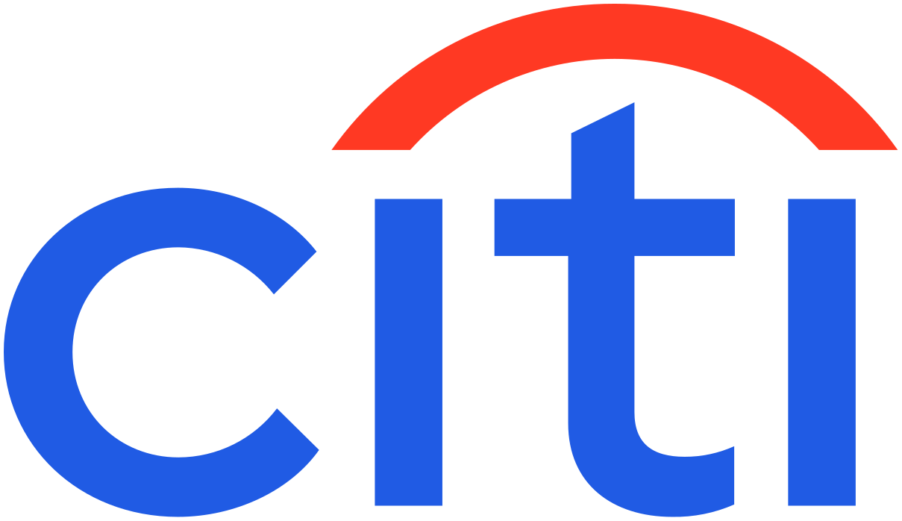







Lessons from Other Banks

